Slide 1
CS5590 Applied Programming Series
Programming for Web/Cloud based Application
Lesson 3

Slide 2
JavaScript
jQuery

Slide 3
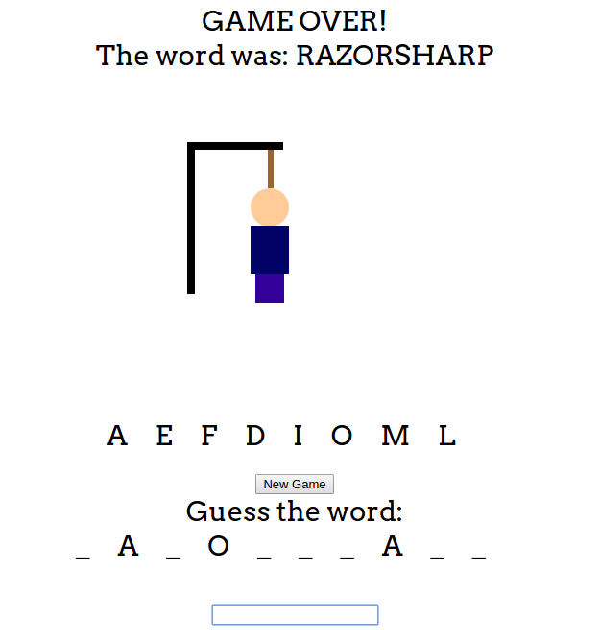
Use Case 1: Hangman using JS

Slide 4
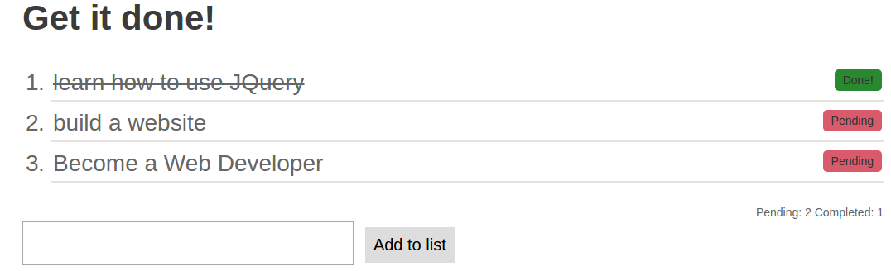
Use Case 2: Todo List

Slide 5
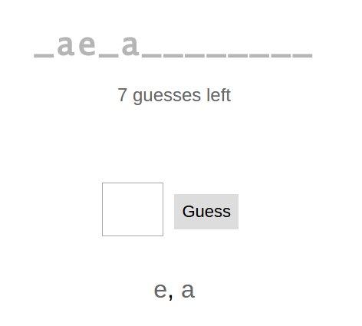
Use Case 3: Hangman using API

Slide 6
JavaScript​

Slide 7
Object
All JavaScript values, except primitives, are objects.
A JavaScript object is a collection of named values called properties.
An object method is an object property containing a function definition.
Methods are actions that can be performed on objects.

Slide 8
Object: Example
var person = { firstName:"John", lastName:"Doe", age:50, eyeColor:"blue" };

Slide 9
this Keyword
the object that "owns" the JavaScript code
value of this, when used in a function, is the object that "owns"
value of this, when used in an object, is the object itself.
It's value is new object when the constructor is used to create an object.

Slide 10
Prototype
Every JavaScript object has a prototype
The prototype is also an object
All JavaScript objects inherit their properties and methods from their prototype
Object.prototype is on the top of the prototype chain
All JavaScript objects inherit from it

Slide 11
Prototype: Creation
Use an object constructor function
//prototype creation
function Person(first, last, age, eyecolor) { this.firstName = first; this.lastName = last; this.age = age; }
//object creation from prototype
var myFather= new Person("John", "Doe", 50, );

Slide 12
Prototype Property
function Person(first, last, age, eyecolor) { this.firstName = first; this.lastName = last; this.age = age;
}
Person.prototype.nationality = "English"
Person.prototype.name = function() { return this.firstName + " " + this.lastName; };

Slide 13
jQuery​

Slide 14
jQuery
Simple js library
helps you find and change html elements on web pages
do things in response to user events.
jQuery is a js function. js function is an object.
$(string), $.ajax(),$(function),$(DOM element)
$()returns an array like object

Slide 15
jQuery Selectors
$("#lastname"), $(".intro"), $(".intro,.demo")
jQuery Event methods
$("input").blur(function(){ alert("This input field has lost its focus."); });
jQuery Effects
$("button").click(function(){ $("p").hide(); });
$("button").click(function(){ $("p").show(); });
jQuery HTML / CSS Methods
$("button").click(function(){ $("p:first").addClass("intro"); });
$("button").click(function(){ $("p").append("<b>Appended text</b>"); });
jQuery Traversing Methods
$(document).ready(function(){ $("h1").add("p").add("span").css("background-color", "yellow");
});

Slide 16
unction appendText() {
var txt1 = "<p>Text.</p>"; // Create text with HTML
var txt2 = $("<p></p>").text("Text."); // Create text with jQuery
var txt3 = document.createElement("p");
txt3.innerHTML = "Text."; // Create text with DOM
$("body").append(txt1, txt2, txt3); // Append new elements
}

Slide 17
Hosting jQuery
Locally
<script src='js/jquery.min.js'> </script>
JQuery Official – Download page
<script src='//code.jquery.com/jquery-3.2.1.min.js'> </script>
Content Delivery Network- Google CDN
<script src="https://ajax.googleapis.com/ajax/libs/jquery/3.2.1/jquery.min.js"></script>

Slide 18
jQuery-Selectors
// all div elements
$('div')
// the element with the ID container
$('#container')
// selects all elements with the class total
$('.total')
Any valid CSS selector can be passed as a string to $().

Slide 19
jQuery Object
$() returns jQuery object.
Returned object refers to selected element
$('#container').text('This is the new text‘)
$(‘.total’).css(‘color’, ‘red’)
Refer the documentation to know about different methods to be used

Slide 20
DOM Traversal Methods
method | Returned element
parent() | parent(one level up)
parents() | Ancestors(many levels up)
children() | One level down
find() | Many levels down
siblings() | Same level
first() | First among returned elements
next() | Immediate following element

Slide 21
Classes, Attributes
Method | definition
addClass() | Adds a class to matched elements
removeClass() | Removes a class from matched elements
toggelClass() | Adds(removes) a Class if absent(present)
attr() | Get/set attribute based on arguments
removeAttr() | Remove attribute from matched elements

Slide 22
Get/Set content
Method | defintion
html() | HTML contents of the first element in the set of matched elements
text() | combined text contents of each element in the set of matched elements, including their descendants
val() | current value of the first element in the set of matched elements
Note: InnerHTML is a browser property. It is the content inside an html element

Slide 23
Elements
Method | Definition
add | Adds an element
remove | Removes an element
target.append( content) | adds content to the end of target(last child)
target.prepend(content) | adds content to the beginning of the target(first child)
insertAfter(target) | Insert every element in the set of matched elements after the target(sibling)
insertBefore(target) | Insert every element in the set of matched elements before the target(sibling)

Slide 24
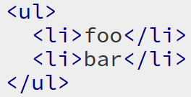
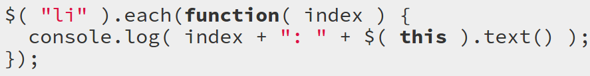

each()
each()-iterate over a jQuery object, executing a function for each matched element.

Slide 25
Event Handling
Events-specific actions occurring at specific times
Eg: mouse clicks, key presses etc
Three Important things to look for
target element to listen to
event we want to react to
the action to take in response->Callback

Slide 26
Event Handling-Syntax
$(target_element) .on(event_type,function(){
// Do something in response to event
})
Eg: $('#my-button').on('click',function(){
$(this).remove();
});

Slide 27
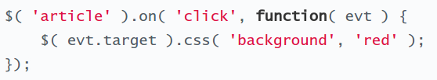
Event Object
when an event occurs event object with a bunch of information is passed to the callback function.
It is referenced generally by e,evt,event

Slide 28
Convenience Methods
$('#my-button').on('click',function(){
$(this).remove();
});
$('#my-button').click(function(){
$(this).remove();
});

Slide 29
Event Delegation
$( 'article' ).on( 'click', function() { $( 'body' ).addClass( 'selected' ); });
$( 'body' ).append( '<article>This is an article </article>' );
Clicking on the "appended" article will not add a class to the body
Appended article was created after event listener was set up

Slide 30
Event Delegation
$( '.container' ).on( 'click', 'article', function() { … });
listen to events that hit a parent element
Pay attention to target of those events
Pass an additional argument to the on method to specify the target

Slide 31
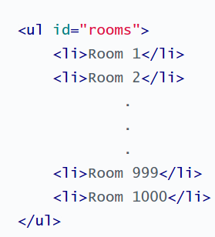
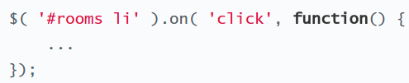
Event Delegation
It can also be used to consolidate the number of event listeners.

Slide 32
RESTful API
An API is an easy way of fetching information from a remote service
A RESTful API uses HTTP requests to GET, PUT, POST and DELETE data.
A browser sends request to and receives response from a server through HTTP.

Slide 33
HTTP Verbs
Verb | CRUD Analogy
POST | Create
GET | Read
PUT | Update/Replace
PATCH | Update/Modify
DELETE | Delete
PUT can also be used for Create operation
Refer this post for more clarity on usage and differences between these verbs.

Slide 34
AJAX
Asynchronous JavaScript and XML .
Update a web page without reloading the page
Request data from a server - after the page has loaded
Receive data from a server - after the page has loaded
Send data to a server - in the background

Slide 35
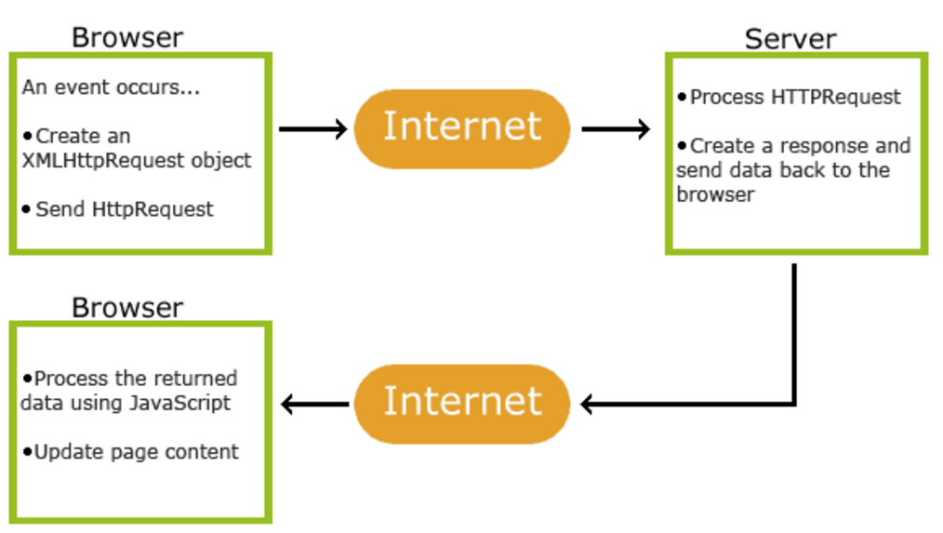
How AJAX works

Slide 36
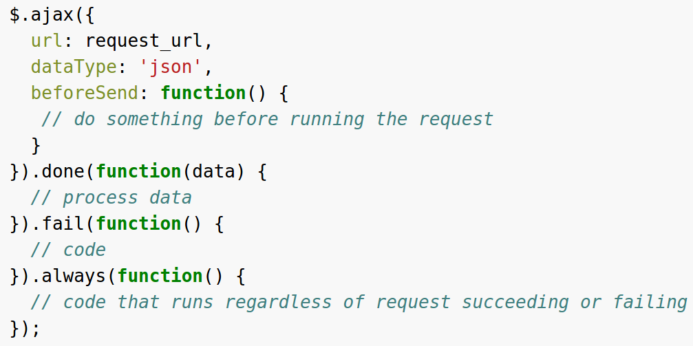
$.ajax()-example

Slide 37
XMLHttp Request Object
var xhttp = new XMLHttpRequest();
object to perform an HTTP or API request
can be used for other formats such as JSON
used to exchange data with a web server behind the scenes
possible to update parts of a web page without reloading

Slide 38
XMLHttp Request -Methods
xhttp.open('GET', url, true)
xhttp.send()
'GET'-HTTP verb
url- url to which request is being made
true- make request asynchronously
Send() sends the request

Slide 39
Handling response
var json = xhrReq.responseText; var myObject = JSON.parse(json)
responseText returns response in JSON format as a string
JSON.parse() turns string into a native JavaScript object

Slide 40
JSON
JSON syntax is derived from JavaScript object notation syntax:
Data is in name/value pairs
Data is separated by commas
Curly braces hold objects
Square brackets hold arrays

Slide 41
JSON
{
login": "octocat", "id": 1, "avatar_url": "https://avatars.githubusercontent.com/u/9906?v=2", "gravatar_id": "", "html_url": "https://github.com/octocat", "type": "User"
}
Refer this for more practical JSON examples.

Slide 42
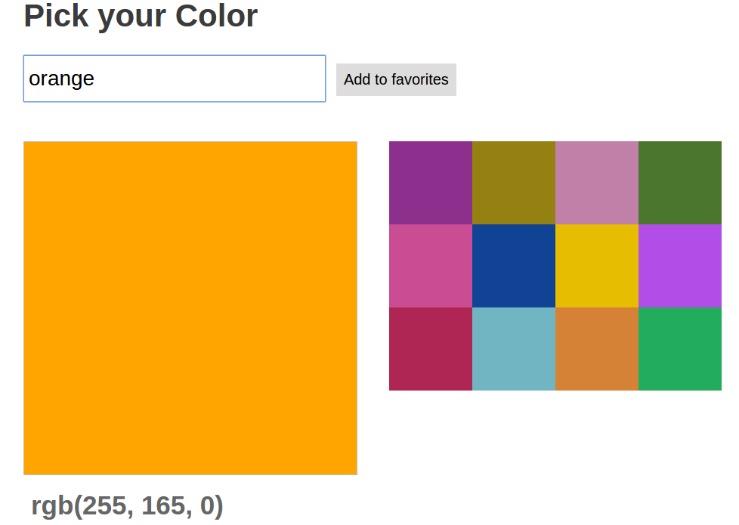
InClassProg- PickMyFavoriteColor
Follow the instructions given in the starter code.

Slide 43
InClassProg-GitHubUserFinder
Create an app which makes call to the GitHub API(https://api.github.com/.) and displays the following when any user is searched by user name.
Name of the user
ID of the user
Profile picture
Link to the user’s account

Slide 44
References
https://www.w3schools.com
https://codebar.io
https://developer.mozilla.org/en-US/
https://api.jquery.com

